Slide 1

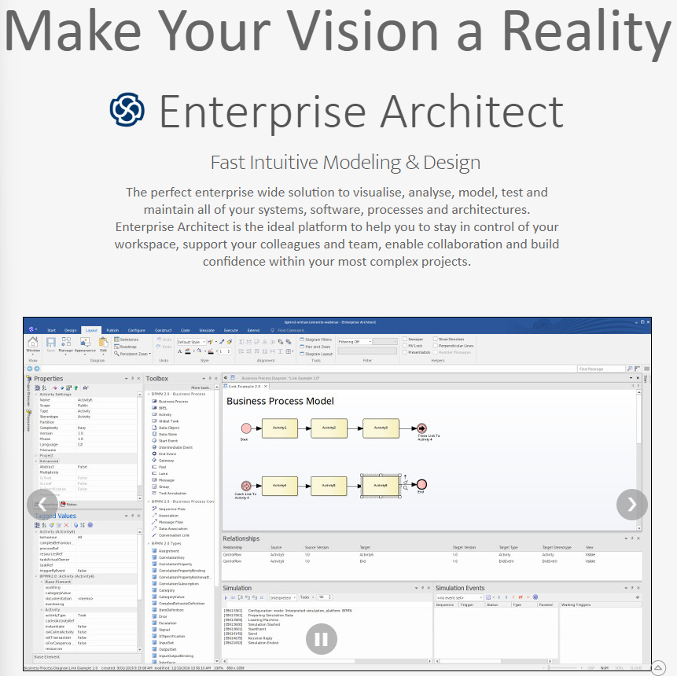
Learning Sparx® Enterprise Architect Tool
001 – Opening and Structure Introduction
Xiaoqi Zhao
https://github.com/yasenstar/enterprise_architecture

Slide 2
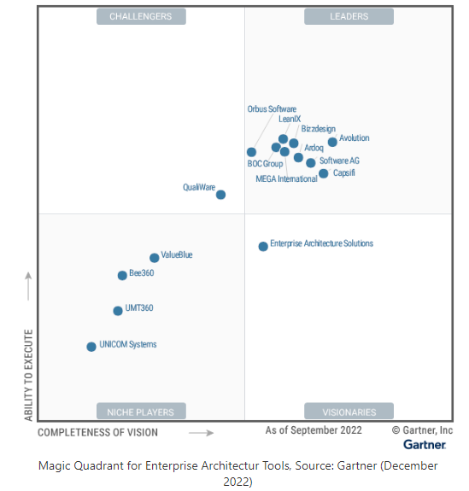
Magic Quadrant for Enterprise Architecture Tools - 2022
Archi – ArchiMate Modeling Tool
Sparx Systems Enterprise Architect

Slide 3
About Sparx Systems
https://sparxsystems.com/about.html
Sparx Systems specializes in high performance and scalable visual modeling tools for the planning, design and construction of software intensive systems.
… Sparx Systems is a leading vendor of innovative solutions based on the Unified Modeling Language (UML) and its related specifications
A Contributing Member of the Object Management Group (OMG), Sparx Systems is committed to realizing the potential of model-driven development based on open standards.
Our software is intended for use by analysts, designers, architects, developers, testers, project managers and maintenance staff - almost everyone involved in a software development project and in business analysis

Slide 4
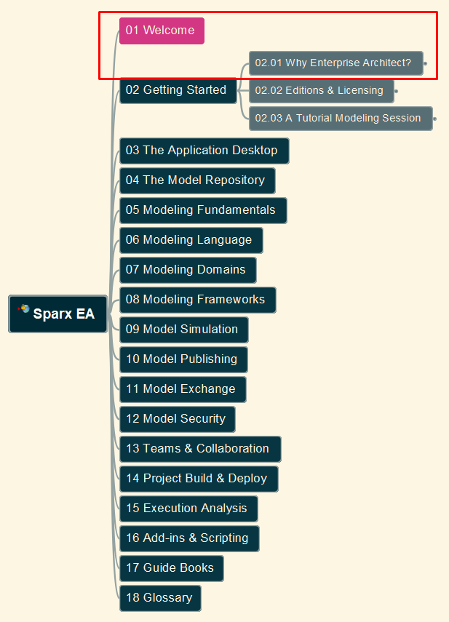
Learning Sparx® Enterprise Architect Tool
002 – Welcome and Why EA, Tool Exploration
Xiaoqi Zhao
https://github.com/yasenstar/enterprise_architecture

Slide 5
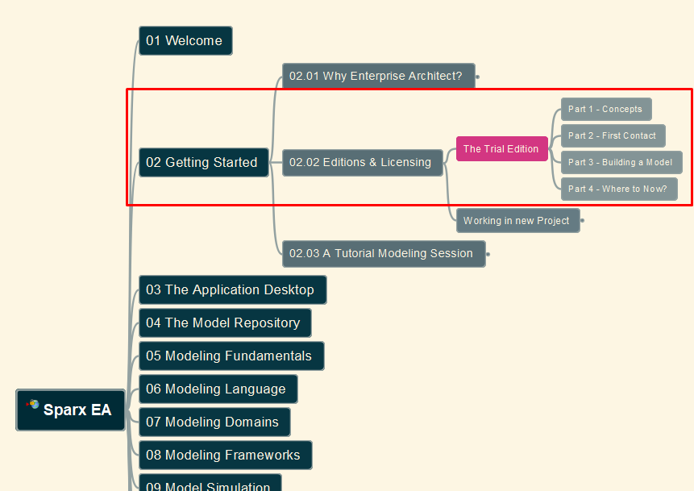
Learning Sparx® Enterprise Architect Tool
003 – Editions/Licensing, Use Trial Edition
Xiaoqi Zhao
https://github.com/yasenstar/enterprise_architecture

